Slide 1
Combining Relations
Example 17. Let A = {1, 2, 3} and B = {1, 2, 3, 4}.
The relation R₁ = {(1,1), (2,2), (3,3)}
and R₂ = {(1,1), (1,2), (1,3), (1,4)} can be
combined to obtain
R₁ ∪ R₂ = {(1,1), (2,2), (3,3), (1,2), (1,3), (1,4)}
R₁ ∩ R₂ = {(1,1)}
R₁ － R₂ = {(2,2), (3,3)}
R₂ － R₁ = {(1,2), (1,3), (1,4)}
R₁ ⊕ R₂ = {(2,2), (3,3), (1,2), (1,3), (1,4)}
symmetric difference, (R₁∪R₂) – (R₁∩ R₂)
Ch8-<number>

Slide 2
Example 18
Let A and B be the set of all students and the set of all courses at a school, respectively. Suppose that R1 consists of all ordered pairs (a, b), where a is a student who has taken course b,andR2 consists of all ordered pairs (a, b), where a is a student who requires course b to graduate.What are the relations R1 ∪ R2, R1 ∩ R2, R1 ⊕ R2, R1 − R2, and R2 − R1?
Solution:
R1 ∪ R2 consists of all ordered pairs (a, b), where a is a student who either has taken course b or needs course b to graduate.
R1 ∩ R2 is the set of all ordered pairs (a, b), where a is a student who has taken course b and needs this course to graduate.
R1 ⊕ R2 consists of all ordered pairs (a, b), where student a has taken course b but does not need it to graduate or needs course b to graduate but has not taken it.
R1 − R2 is the set of ordered pairs (a, b), where a has taken course b but does not need it to graduate; that is, b is an elective course that a has taken.
R2 − R1 is the set of all ordered pairs (a, b), where b is a course that a needs to graduate but has not taken.
Ch8-<number>

Slide 3
Example 19
Let R1 be the “less than” relation on the set of real numbers and let R2 be the “greater than”relation on the set of real numbers, that is, R1 = {(x, y) | x < y} and R2 = {(x, y) | x > y}.What are R1 ∪ R2, R1 ∩ R2, R1 − R2, R2 − R1, and R1 ⊕ R2?
Solution:
(x, y) ∈ R1 ∪ R2 if and only if (x, y) ∈ R1 or (x, y) ∈ R2.
Hence, (x, y) ∈ R1 ∪ R2 if and only if x < y or x > y i.e., x! = y,
R1 ∪ R2 = {(x, y) | x! = y}.
R1 ∩ R2 = ∅ , x< y andx > y
R1 − R2 = R1
R2 − R1 = R2
R1 ⊕ R2 = R1 ∪ R2 − R1 ∩ R2 = {(x, y) | x! = y}.
Ch8-<number>

Slide 4
Def 6. Let R be a relation from a set A to a set B and S a relation from B to a set C. The composite of R and S is the relation consisting of ordered pairs (a,c), where a∈A, c∈C, and for which there exists an element b∈B such that (a,b)∈R and (b,c)∈S. We denote the composite of R and S by S °R.
Example 20. What is the composite of relations R and S, where R is the relation from {1, 2, 3} to {1, 2, 3, 4} with R = {(1, 1), (1, 4), (2, 3), (3, 1), (3, 4)} and S is the relation from {1, 2, 3, 4} to {0, 1, 2} with S = {(1, 0),
(2, 0), (3, 1), (3, 2), (4, 1)}?
Sol. S °R is the relation from {1, 2, 3} to {0, 1, 2} with
S °R = {(1, 0), (1,1), (2, 1), (2, 2), (3, 0), (3, 1)}.
Ch8-<number>

Slide 5
Def 7. Let R be a relation on the set A.
The powers R^{n}, n = 1, 2, 3, …, are defined recursively by R¹ = R and R^{n+1} = R^{n} °R.
Example 22. Let R = {(1, 1), (2, 1), (3, 2), (4, 3)}.
Find the powers R^{n}, n=2, 3, 4,….
Sol. R² = R °R = {(1, 1), (2, 1), (3, 1), (4, 2)}.
R³ = R² °R = {(1, 1), (2, 1), (3, 1), (4, 1)}.
R⁴ = R³ °R = {(1, 1), (2, 1), (3, 1), (4, 1)} = R³.
Therefore R^{n} = R³ for n=4, 5, ….
Thm 1. The relation R on a set A is transitive if and
only if R^{n} ⊆ R for n = 1, 2, 3, ….
Ch8-<number>

Slide 6
n-ary Relations and Their Applications
Relationship involving the name of a student, the student’s major, and the student’s grade point average.
Relationship involving the airline, flight number, starting point, destination,departure time, and arrival time of a flight.
relationships among elements from more than two sets are called n-ary relations.
These relations are used to represent computer databases.
EX: Which flights land at O’Hare Airport between 3 a.m. and 4 a.m.?
Which students at your school are sophomores majoring in mathematics or computer science and have greater than a 3.0 average?
Which employees of a company have worked for the company less than 5 years and make more than $50,000?

Slide 7
n-ary Relations
DEFINITION 1
Let A₁,A₂, . . . , A_{n} be sets.An n-ary relation on these sets is a subset ofA₁ × A₂ ×・ ・ ・× A_{n} The sets A₁,A₂, . . . , A_{n} are called the domains of the relation, and n is called its degree.
EXAMPLE 1
Let R be the relation on N × N × N consisting of triples (a, b, c), where a, b, and c are integers witha < b < c. Then (1, 2, 3) ∈ R, but (2, 4, 3)!∈R.
The degree of this relation is 3. Its domains are all equal to the set of natural numbers.

Slide 8
EXAMPLE 2
Let R be the relation on Z × Z × Z consisting of all triples of integers (a, b, c) in which a, b, and c form an arithmetic progression.
(a, b, c) ∈ R if and only if there is an integer k such that
b = a + k and c = a + 2k,
b − a = k and c − b = k.
(1, 3, 5) ∈ R because 3 = 1 + 2 and 5 = 1 + 2 ・ 2,
but (2, 5, 9) !∈ R because 5 − 2 = 3 while 9 − 5 = 4.
This relation has degree 3 and its domains are all equal to the set of integers.

Slide 9
EXAMPLE 3
LetR be the relation onZ × Z × Z+ consisting of triples (a, b, m), where a, b, and m are integers with m ≥ 1 and a ≡ b (mod m).
(8, 2, 3), (−1, 9, 5), and (14, 0, 7) ∈ R,
but (7, 2, 3), (−2,−8, 5), and (11, 0, 6) !∈ R
8 ≡ 2 (mod 3),−1 ≡ 9 (mod 5), and 14 ≡ 0 (mod 7),
but 7 ≡ 2 (mod 3), −2 ≡ −8 (mod 5), and 11 ≡ 0 (mod 6).
This relation has degree 3 and its first two domains are the set of all integers and its third domain is the set of positive integers.

Slide 10
EXAMPLE 4
Let R be the relation consisting of 5-tuples (A,N, S,D, T ) representing airplane flights, where A is the airline, N is the flight number, S is the starting point, D is the destination, and T is the departure time.
sol:
if Nadir Express Airlines has flight 963 from Newark to Bangor at 15:00, then (Nadir, 963, Newark, Bangor, 15:00) ∈ R.
The degree of this relation is 5, and its domains are the set of all airlines, the set of flight numbers, the set of cities, the set of cities (again), and the set of times.

Slide 11
Databases and Relations
The time required to manipulate information in a database depends on how this information is stored.
The operations of adding and deleting records, updating records, searching for records, and combining records from overlapping databases are performed millions of times each day in a large database.
Because of the importance of these operations, various methods for representing databases have been developed.
A database consists of records, which are n-tuples, made up of fields.
The fields are the entries of the n-tuples.

Slide 12
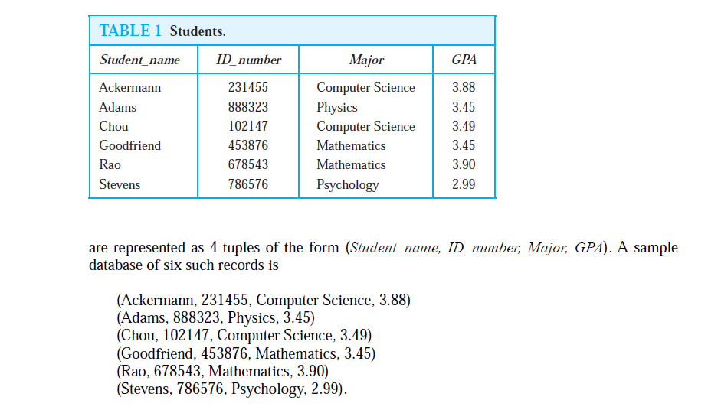
student records

Slide 13
Databases and Relations
Relations used to represent databases are also called tables.
Each column of the table corresponds to an attribute of the database.
For instance, the same database of students is displayed in Table 1.
The attributes of this database are Student Name, ID Number, Major, and GPA.
A domain of an n-ary relation is called a primary key when the value of the n-tuple from this domain determines the n-tuple.
Domain is a primary key when no two n-tuples in the relation have the same value from this domain.

Slide 14
Databases and Relations
Records are often added to or deleted from databases.
So,domain is a primary key is time-dependent.
A primary key should be chosen that remains one whenever the database is changed.
The current collection of n-tuples in a relation is called the extension of the relation.
The more permanent part of a database, including the name and attributes of the database, is called its intension.
When selecting a primary key, select a key that can serve as a primary key for all possible extensions of the database.
To do this, it is necessary to examine the intension of the database to understand the set of possible n-tuples that can occur in an extension.

Slide 15
EXAMPLE 5
Which domains are primary keys for the n-ary relation displayed in Table 1, assuming that no n-tuples will be added in the future?
Solution:
domain of student names is a primary key.
ID numbers in this table are unique, so the domain of ID numbers is also a primary key.
domain of major fields of study is not a primary key, because more than one 4-tuple contains the same major field of study.
domain of grade point averages is also not a primary key, because there are two 4-tuples containing the same GPA.

Slide 16
composite key
Combinations of domains can also uniquely identify n-tuples in an n-ary relation.
When the values of a set of domains determine an n-tuple in a relation, the Cartesian product of these domains is called a composite key.
EXAMPLE 6
Is the Cartesian product of the domain of major fields of study and the domain of GPAs a composite key for the n-ary relation from Table 1, assuming that no n-tuples are ever added?
Solution:
Because no two 4-tuples from this table have both the same major and the same GPA,this Cartesian product is a composite key.
Because primary and composite keys are used to identify records uniquely in a database, it is important that keys remain valid when new records are added to the database.

Slide 17
Operations on n-ary Relations
Operations can answer queries on databases that ask for all n-tuples that satisfy certain conditions.
find all the records of all computer science majors in a database of student records.
find all students who have a grade point average above 3.5
find the records of all computer science majors who have a grade point average above 3.5.
selection operator
Let R be an n-ary relation and C a condition that elements in R may satisfy. Then the selection operator s_{C} maps the n-ary relation R to the n-ary relation of all n-tuples from R that satisfy the condition C.

Slide 18
Example
To find the records of computer science majors in the n-ary relation R shown in Table 1,
C1 is the condition Major=“Computer Science.”
The result is the two 4-tuples (Ackermann, 231455, Computer Science, 3.88) and (Chou, 102147, Computer Science, 3.49).
To find the records of students who have a grade point average above 3.5 in this database
C2 is the condition GPA > 3.5.
The result is the two 4-tuples (Ackermann, 231455, Computer Science, 3.88) and (Rao, 678543, Mathematics, 3.90).
Finally, to find the records of computer science majors who have a GPA above 3.5, we use the operator sC3 ,
C3 is the condition (Major=“Computer Science” ∧ GPA > 3.5).
The result consists of the single 4-tuple (Ackermann, 231455, Computer Science, 3.88).

Slide 19
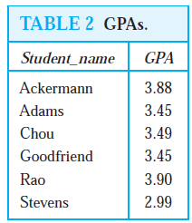
Projections
Projections are used to form new n-ary relations by deleting the same fields in every record of the relation.
The projection P+where i1 < i2 < ・ ・ ・ < im, maps the n-tuple (a1, a2, . . . , an) to them-tuple (ai1 , ai2, . . . , aim), where m ≤ n.
What relation results when the projection P1,4 is applied to the relation in Table 1?

Slide 20
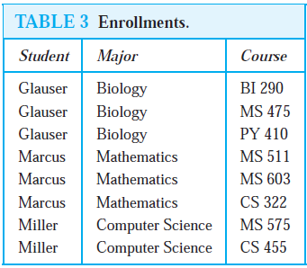
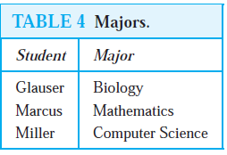
Example
What is the table obtained when the projection P1,2 is applied to the relation in Table 3?

Slide 21
Join
The join operation is used to combine two tables into one when these tables share some identical fields.
For instance, a table containing fields for airline, flight number, and gate, and another table containing fields for flight number, gate, and departure time can be combined into a table containing fields for airline, flight number, gate, and departure time.
Let R be a relation of degree m and S a relation of degree n. The join Jp(R, S),
where p ≤ m and p ≤ n, is a relation of degree m + n − p that consists of all
(m + n − p)-tuples (a1, a2, . . . , am−p, c1, c2, . . . , cp, b1, b2, . . . , bn−p), where them-tuple (a1, a2, . . . , am−p, c1, c2, . . . , cp) belongs to R and the n-tuple (c1, c2, . . . , cp, b1, b2, . . . , bn−p) belongs to S.

Slide 22
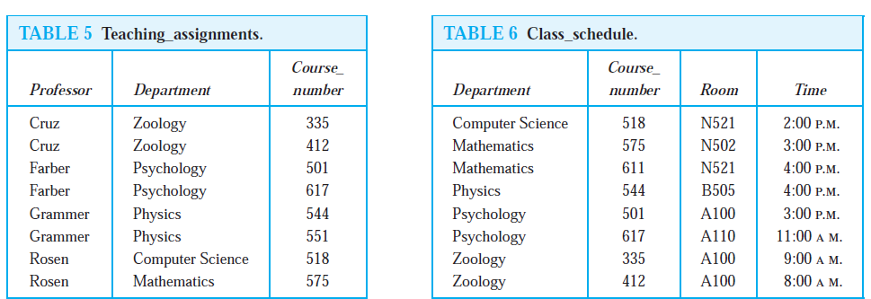
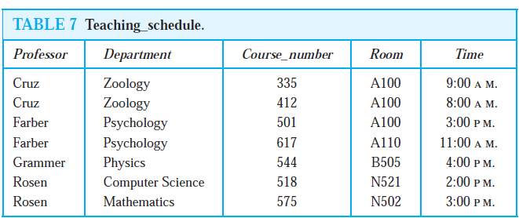
Example
What relation results when the join operator J2 is used to combine the relation displayed in Tables 5 and 6?

Slide 23
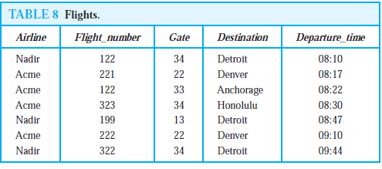
SQL
The database query language SQL(Structured Query Language) can be used to carry out the operations(SELECTION,PROJECTION,JOIN).
SELECT Departure_time FROM Flights WHERE Destination=’Detroit’

